Slide 1

Group 6: Fraud Detection
Himansh
Jainil
Sujith
Vishrut

Slide 2
Introduction
Bridging AI and Databases for Fraud Prevention
Our Breakthrough Approach: We embed a powerful Convolutional Neural Network (CNN) directly inside our Spark ecosystem using User Defined Function (UDF). This allows us to run advanced machine learning models as part of standard SQL queries.
Why This Matters:
Instantly verify IDs as soon as they are uploaded—no need for external systems or manual review.
Automated fraud checks become a seamless part of everyday data operations, boosting both speed and security for banks and online platforms.
By running machine learning models directly within SQL queries, our system processes large volumes of data efficiently—no data movement between systems, minimal latency, and the ability to handle thousands of checks per hour without slowdowns

Slide 3
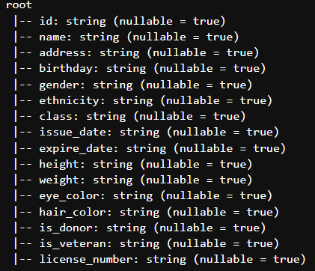
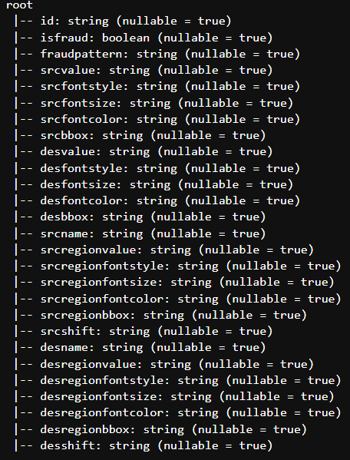

Dataset Schema
idmeta idlabel idimage
Notes:
Add Num of row per table

Slide 4
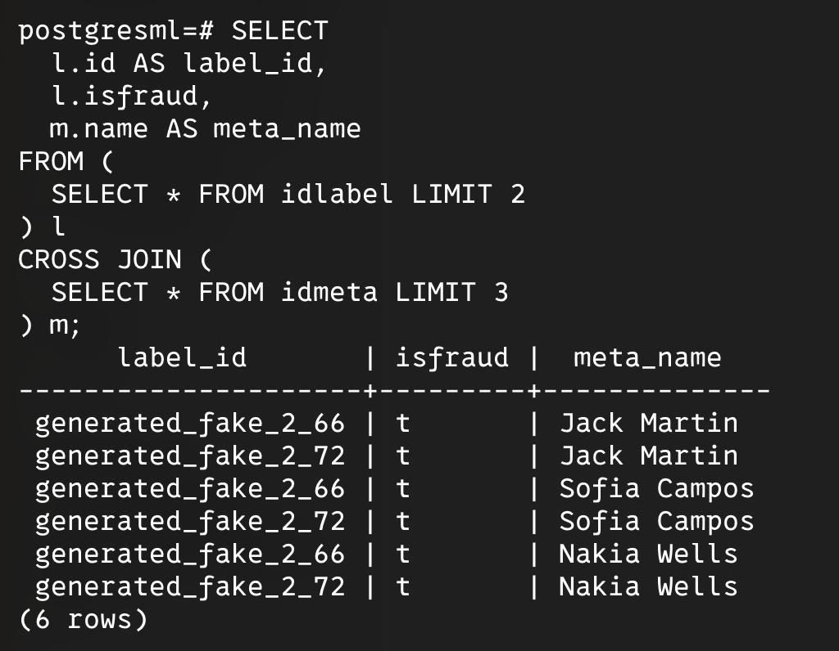
Environment / Technologies used
First we tried using velox. However, it was difficult to set up.
Then we switched to PostgreSQL and decided to leverage UDFs of PostgreSQL. However, there are lot of constraints in UDF, we decided to explore other options. So, we were only able to run simple queries which does not use user defined functions

Slide 5
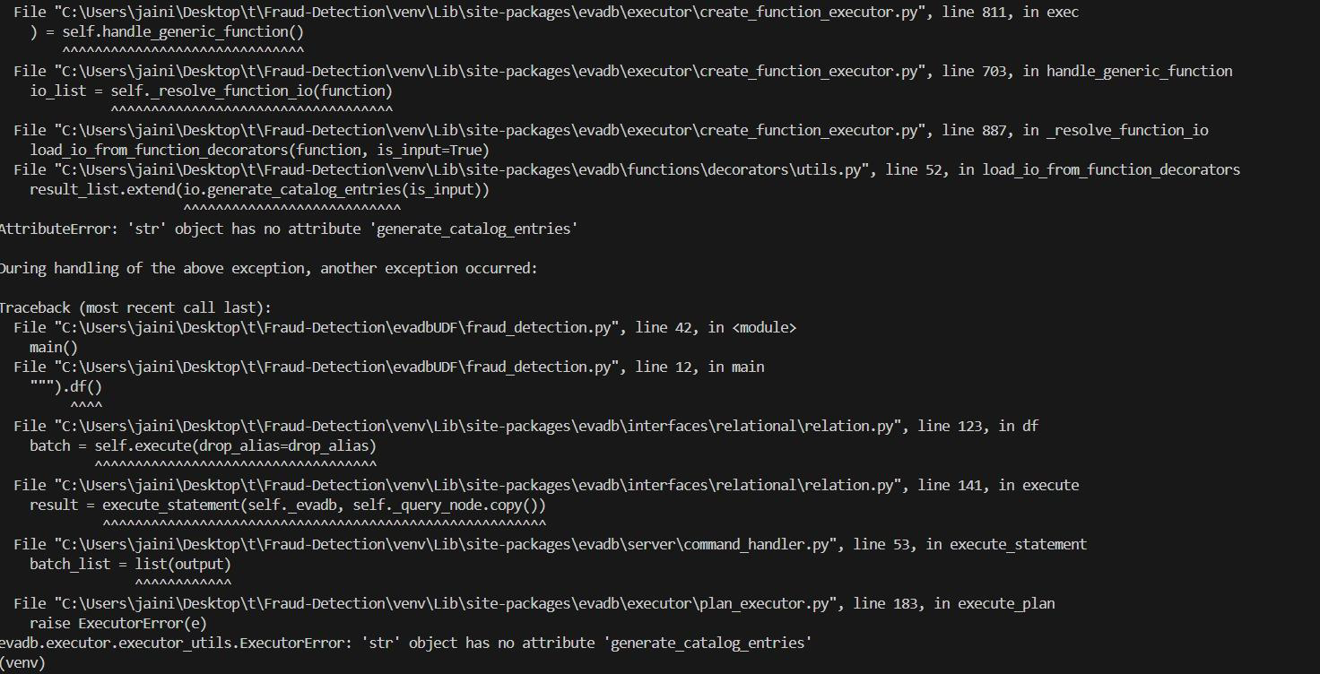
We also explored EvaDB, however, it doesnt support multi dimensional tensors and only allows simple ML models such as XGBoost and Linear/Logistic Regression with simple and definite data types.
So, Finally we decided to use Spark ecosystem which allows us to use complex ML models in UDFs.

Slide 6
Tech tried and problems encountered tables
Technology Tried | Intended Use / Approach | Problem Encountered / Limitation | Outcome
Velox | Initial technology exploration | Difficult to set up | Abandoned; switched to other options
PostgreSQL | Leverage UDFs for ML models | Significant constraints in UDF implementation | Could only run simple queries (without ML UDFs); explored other options
EvaDB | Alternative for database ML integration | Doesn't support multi-dimensional tensors (needed for CNNs); only supports simple ML models (e.g.Regression) & simple data types. | Not suitable for the required complex models (CNN); abandoned
Spark Ecosystem | Embed complex ML models (like CNNs) via UDFs |  | Final chosen solution

Slide 7
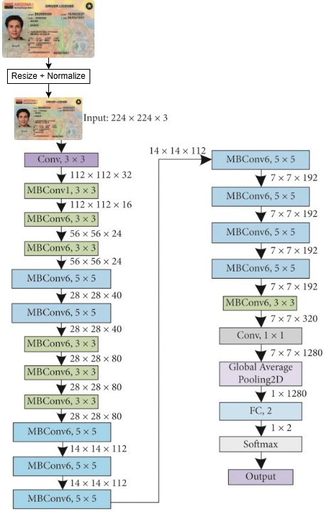
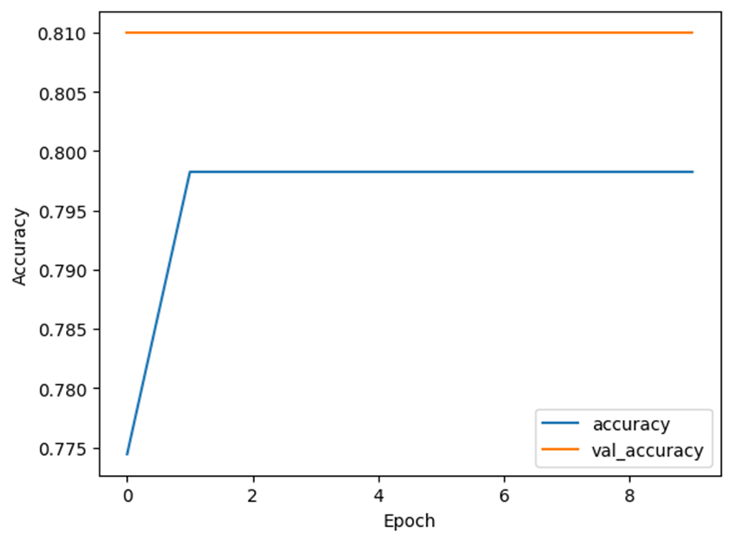
Model Tried - EfficientNetB0 (Common Lightweight CV model)
Architecture | Results | Problems
 | Accuracy : 81% | Poor Generalization to Domain-Specific Task Ineffective Fine-tuning Excessive Model Complexity
Notes:
Add text box/ss for the udf registration
HOw queries are run (step/order of sql execution) in spark in detail (to infer why more time/less time query wise (query optimization in spark changes after udf?) SELECT
m.ethnicity,
COUNT(*) AS total_customers,
SUM(CASE WHEN cnn_fraud_detector_sql(i.imageData) THEN 1 ELSE 0 END) AS predicted_fraud,
100.0 * SUM(CASE WHEN cnn_fraud_detector_sql(i.imageData) THEN 1 ELSE 0 END) / COUNT(*) AS fraud_rate_pct
FROM {image_table} i
JOIN {label_table} l
ON i.name = l.id
JOIN {meta_table} m
ON l.id = m.id
GROUP BY m.ethnicity
ORDER BY fraud_rate_pct DESC
LIMIT 10

Slide 8
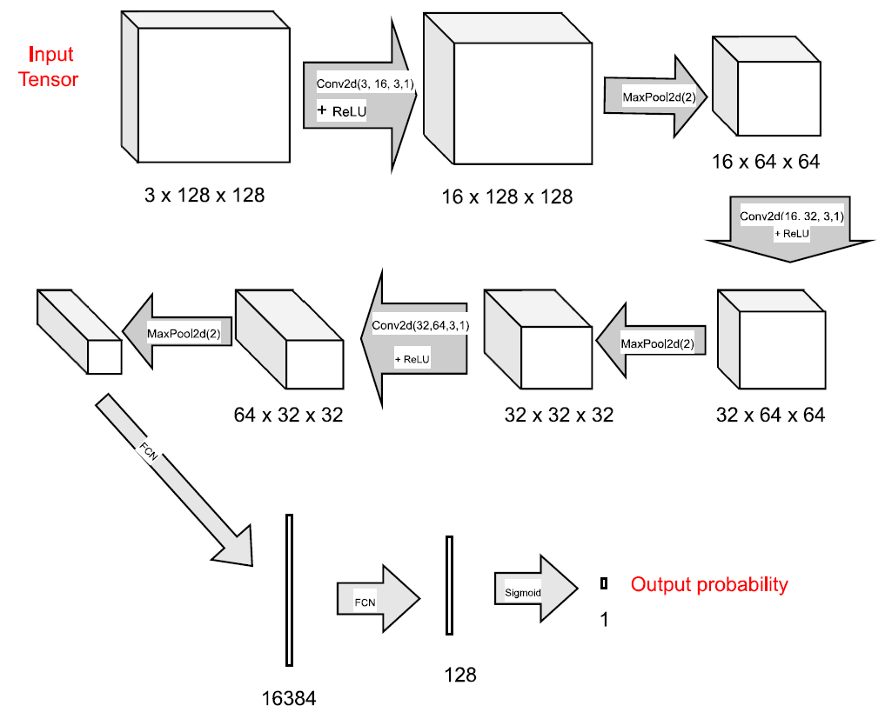
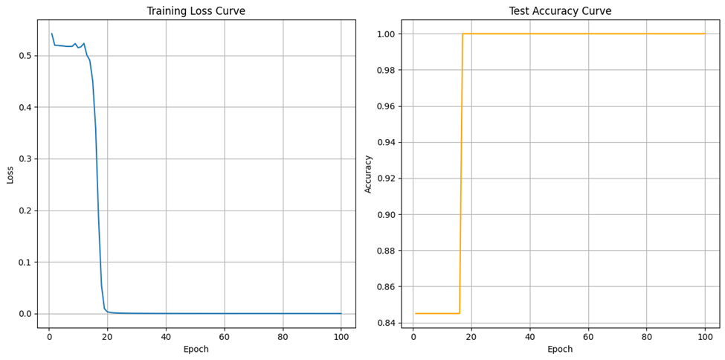
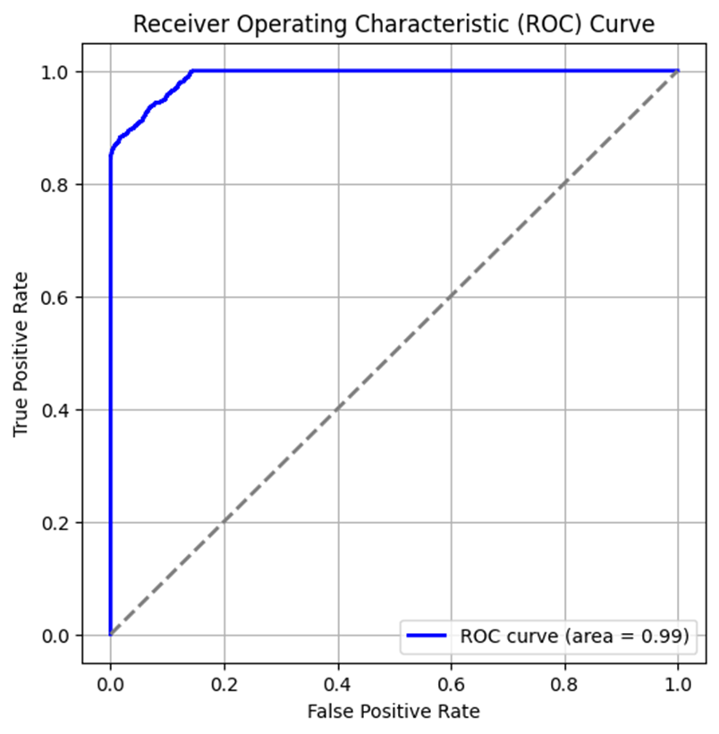
Model Used - Custom CNN (3 Layers of Convolutions)
Architecture | Results | Remarks
 |  | Simpler Model, Better Fit for Small Datasets Adaptable to Dataset Effective Training

Slide 9
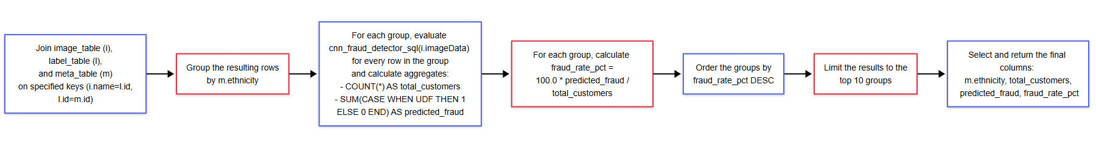
Methodology
Notes:
Add text box/ss for the udf registration
HOw queries are run (step/order of sql execution) in spark in detail (to infer why more time/less time query wise (query optimization in spark changes after udf?) SELECT
m.ethnicity,
COUNT(*) AS total_customers,
SUM(CASE WHEN cnn_fraud_detector_sql(i.imageData) THEN 1 ELSE 0 END) AS predicted_fraud,
100.0 * SUM(CASE WHEN cnn_fraud_detector_sql(i.imageData) THEN 1 ELSE 0 END) / COUNT(*) AS fraud_rate_pct
FROM {image_table} i
JOIN {label_table} l
ON i.name = l.id
JOIN {meta_table} m
ON l.id = m.id
GROUP BY m.ethnicity
ORDER BY fraud_rate_pct DESC
LIMIT 10

Slide 10
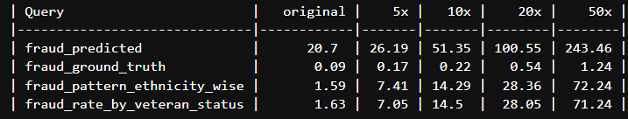
Spark results run time
Query and time it takes to execute on different dataset sizes

Slide 11
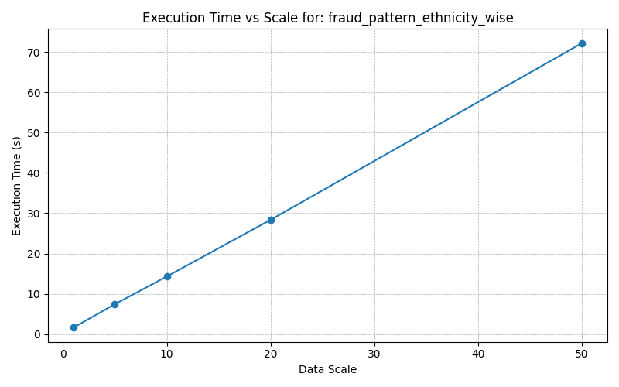
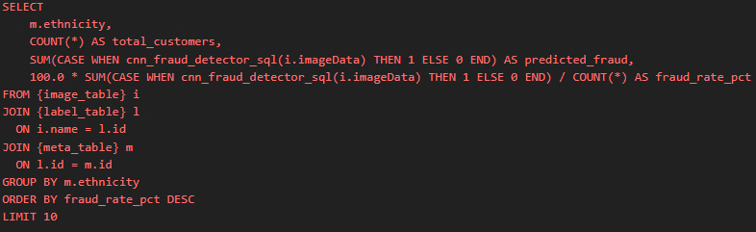
Spark results

Slide 12
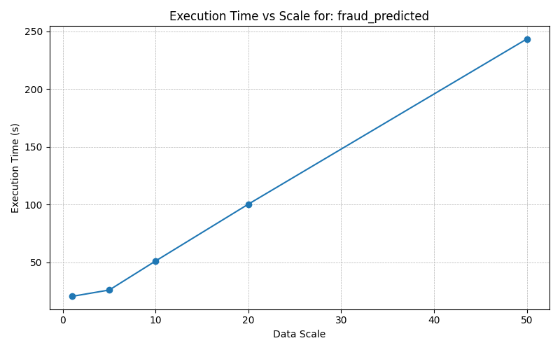

Spark results

Slide 13

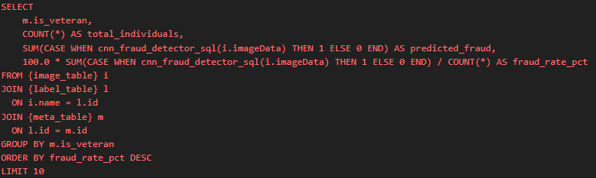
Spark results

Slide 14
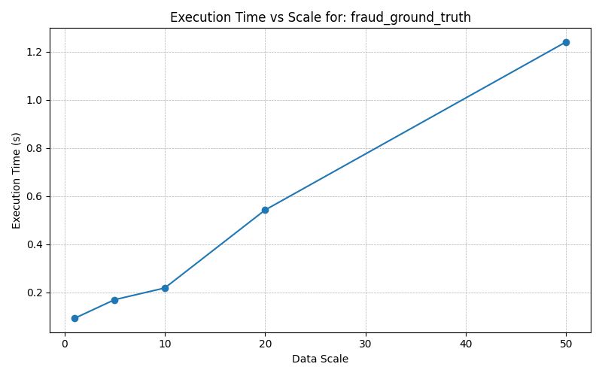
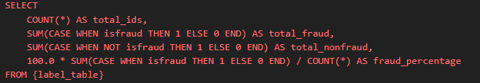
Spark results

Slide 15
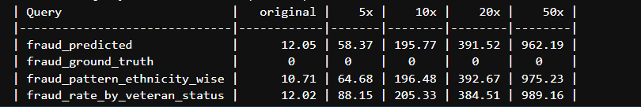
Pandas Results

Slide 16
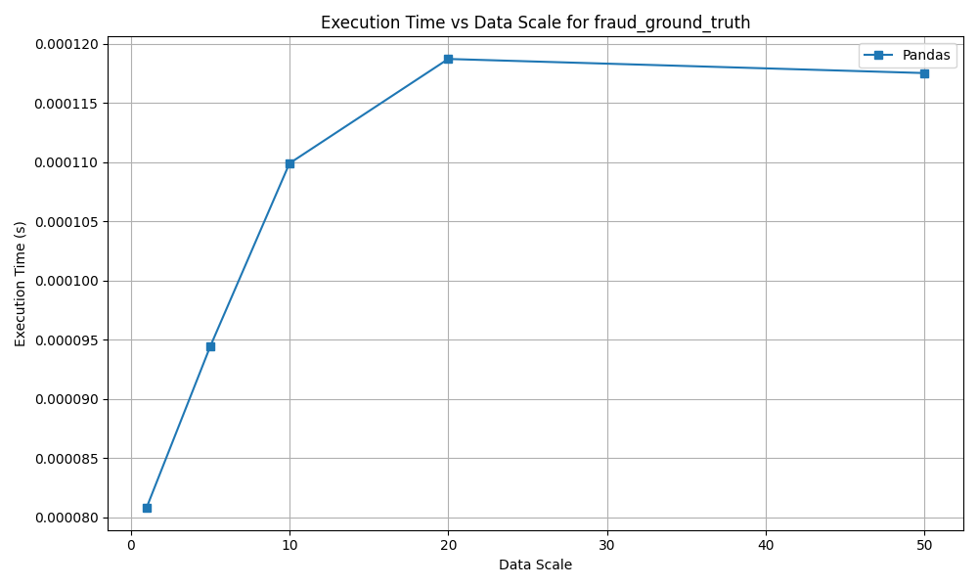
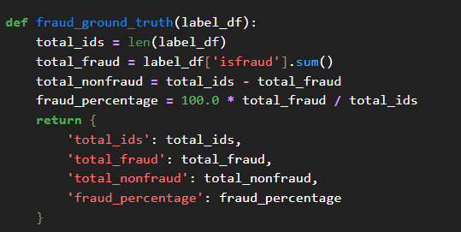
Pandas Results

Slide 17
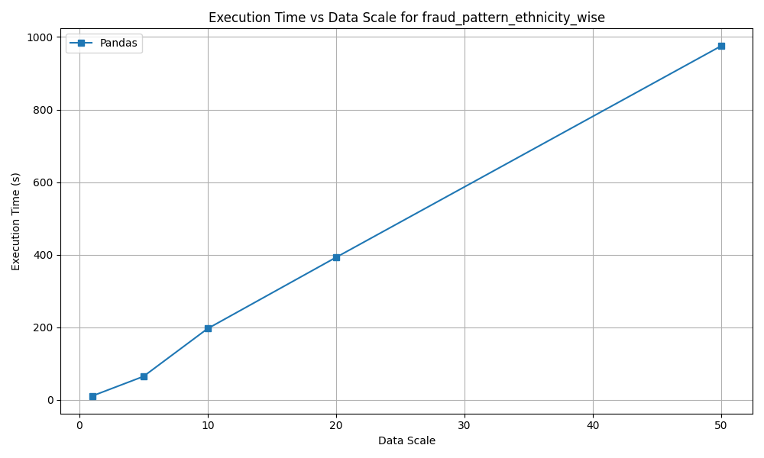
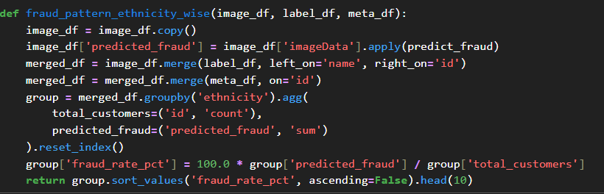
Pandas Results

Slide 18
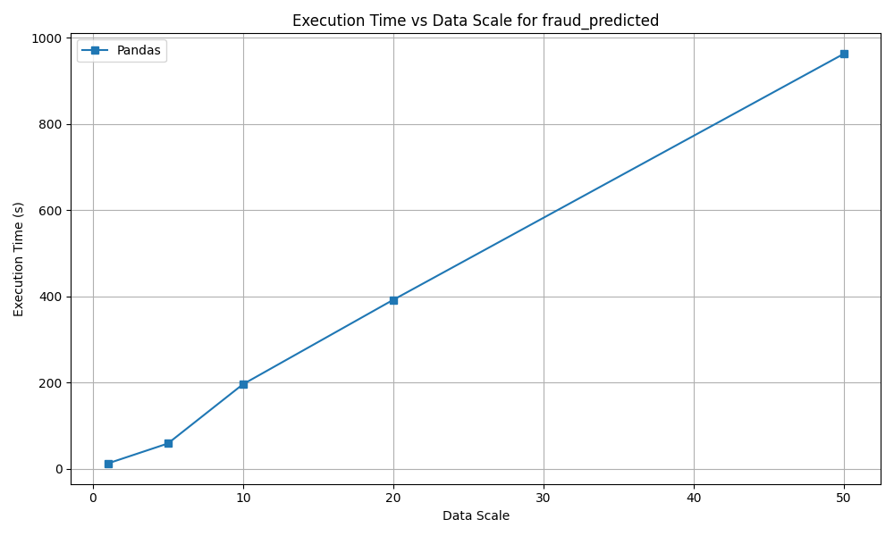
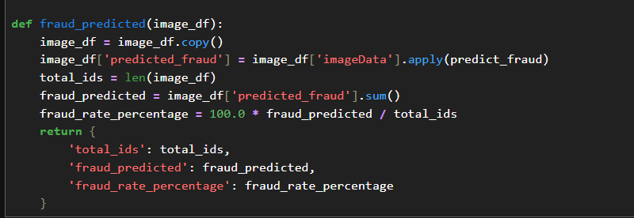
Pandas Results

Slide 19
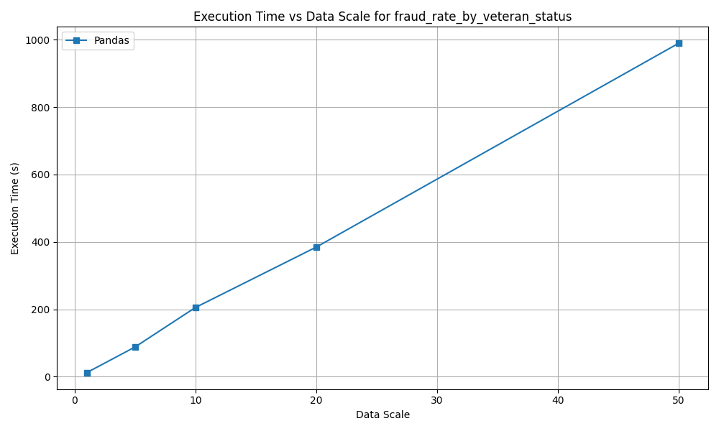
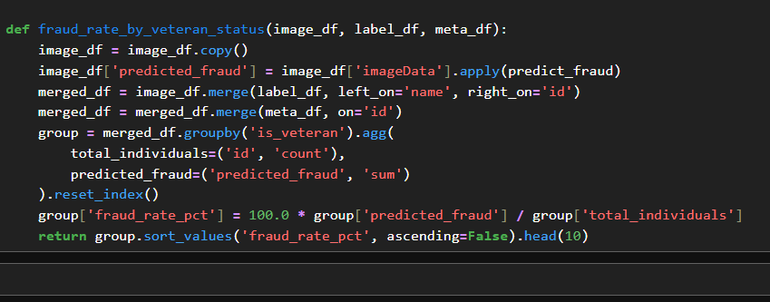
Pandas Results

Slide 20
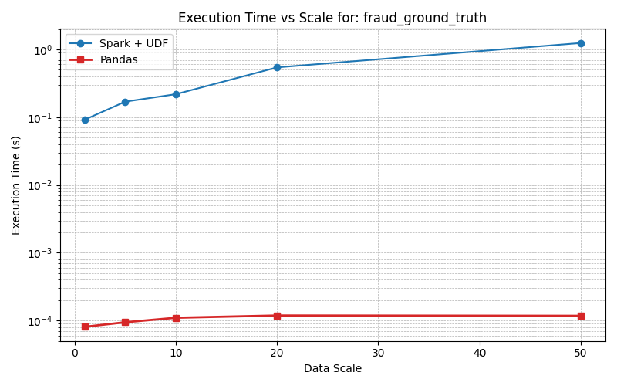
Pandas v/s Spark

Slide 21
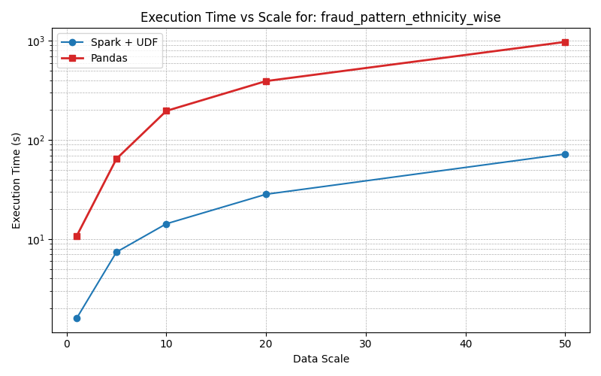
Pandas v/s Spark

Slide 22
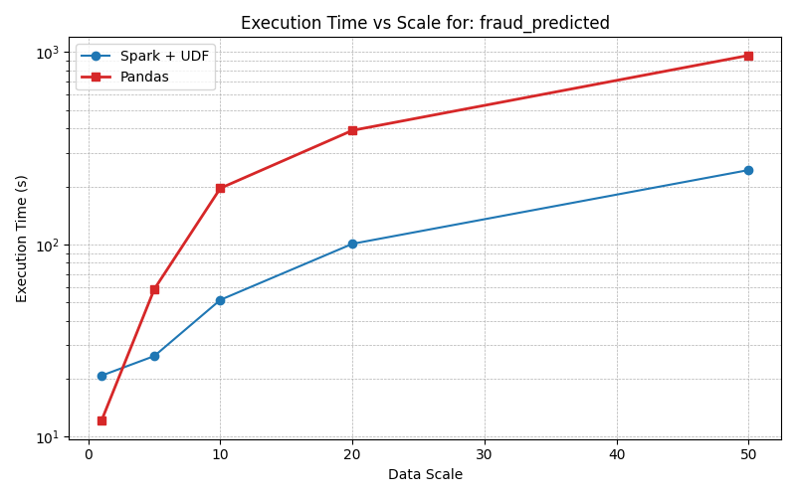
Pandas v/s Spark

Slide 23
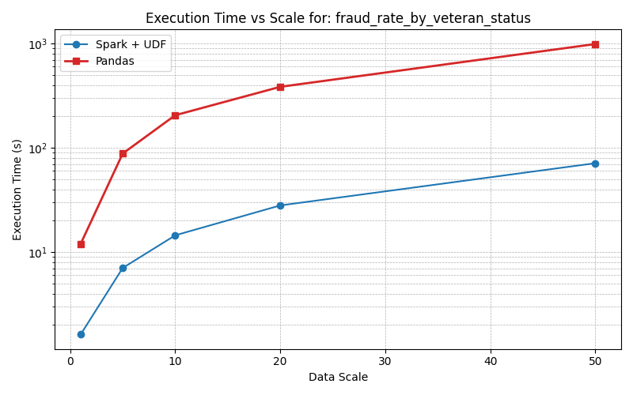
Pandas v/s Spark

Slide 24
Demo

Slide 25
Thank You

